Slide 1

LaunchCode Liftoff
Class 1
Hank DeDona
8/2/2021

Slide 2
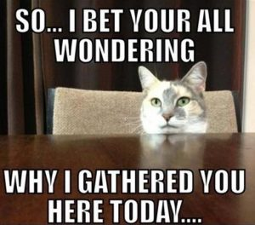
Agenda
Liftoff Overview
Capstone Overview
Prep Work Review
Lecture
Group Introductions
Exercise - Story Mapping
Activity - Project Overview
Q&A

Slide 3
Liftoff Overview

Slide 4

What is Liftoff?
Work Towards Capstone Project
Interview and Job Readiness including: Live coding!!!
Introduction to software engineering topics such as:
SDLC
Deployments
Wireframing & UI/UX
Cloud Services/Microservices
Git
Notes:
A bridge from tech readiness, to job readiness
Focused on Having a Capstone to Present, not a “finished” one
Confidence in interviewing - Technical and Behavioral
Understanding modern software development processes - Agile, UX
8:30 - Be respectful of mentors & staff’s time, we need sleep too!
Similar LC101 format - Prep work, lecture, in-class demos & activities, and assignments
No requirements - self directed program (20 hrs) - Give you the tools & resources
This program does not guarantee you a job, you should still push yourself to grow and learn beyond the class

Slide 5
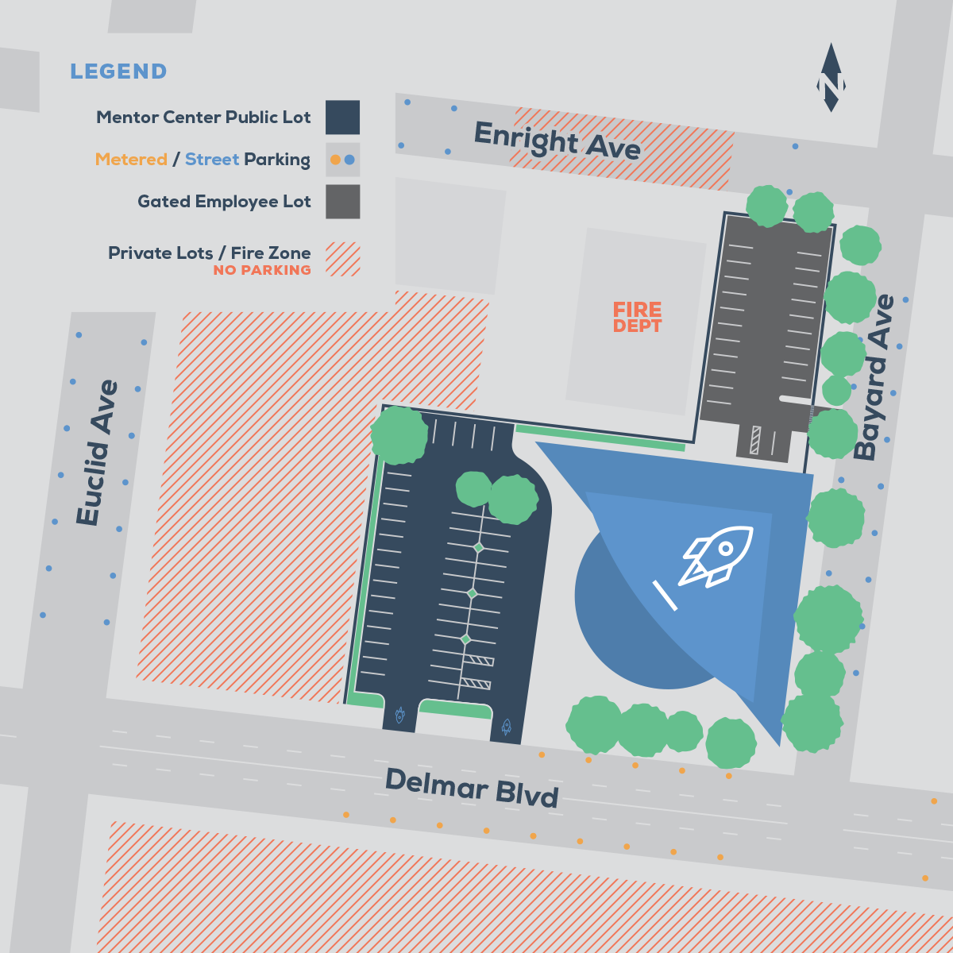
Logistics
8 weeks + 1 break week (Sept 6th)
Only on Mondays
5:30 pm - 8:30 pm CDT
Virtual via ZOOOOOOM!
FYI: Canvas will reflect DIFFERENTLY than the textbook!
Notes:
Respectful of time
If you want someone to walk out to your car, let us know

Slide 6
Capstone Overview

Slide 7

Capstone Expectations
Demonstrate Marketable Skills
Demonstrate Ability to Learn Things
Solve a Problem
3-5 Features
Should show off a typical 3-tiered
architecture
See Example Projects
Notes:
Marketable - We want to get you a job - It’s not the end of the world
Spring Boot or .NET MVC - Others, work with mentor. Mentors, reach out
More than just following a tutorial, but built
Could be a JS front end, api, more feature ideas later
Employers are looking for ability to learn, not master
Problem - Not a game, blog, or cheese catalog
Think about your interests, organizations, and jobs

Slide 8
Capstone Feature Ideas
User Accounts
Secure Login*
Profile Management
Access Levels
“Friends” Network
3rd Party API Integration
SMS (Twillio)
Payments (Stripe)
Dynamic Front End
JavaScript
Mobile Responsive
Google Maps Integration
Graphs & Dashboards
Photo Upload and Sharing
Social Media Integration

Slide 9
Liftoff Project Timeline
Brainstorming and User Stories
Initial Features
Class 1
Class 3
Class 2
Class 4
Wireframes
Project Review 1
Notes:
Aggressive goals so we can provide as much direction as possible
Weekly progress
Something to review by Week 4
Break week

Slide 10
Liftoff Project Timeline
Address Feedback
Next Features
Class 5
Class 7
Class 6
Class 8
Next Features
Final Review
Notes:
More open format towards the end, start adding features
Final project review - May not be complete, but a good start

Slide 11
Class Expectations

Slide 12

Responsibilities - Community Engagement Manager
John Woolbright
Answer any questions about the placement and apprenticeship process
Post-class help
Additional mentorship

Slide 13

Responsibilities - Instructor
Expand on Prep Work In Class Lecture
Facilitate Group Activities
Make Class Accessible
Mentor (i.e. answer your questions :P)
Notes:
Won’t review Prep in depth, but rather touch on and open for questions/discussion
Lecture on important concepts - open discussion from students and mentors
Keep us on time
Accessibility, inclusion, etc

Slide 14

Responsibilities – Teaching Fellow
Provide Guidance and Feedback
Act as sounding board for your ideas
Tackle “Blockers”
Connect you with Mentors and Resources
Attendance and Grading

Slide 15

Responsibilities - Student
Dedicate Time Outside of Class - 20 hours
Provide a Weekly Update to Your Group
Engaged in Lecture and Activities
Complete Prep Work and Assignments
Come Prepared to Class
https://education.launchcode.org/liftoff/articles/liftoff-expectations/
Notes:
20 hours is a lot, but you definitely should have multiple times a week you can dedicate
Weekly Updates - Want to see forward progress & get comfortable talking about it
Try not to ‘work’ during lecture & activities, or leave early
CoC and Harassment - Won’t stand for it, reach out to staff or myself
We don’t run this class because we love grading & lecturing (okay, I like lecturing)
Bring laptop, notebook, pen (especially next week)

Slide 16

Prep Work
Liftoff Overview
Capstone Project Guidelines
Fork GitHub Assignment Repository
Trello Setup
Git Refresher – We will cover this in class 2
Understanding User Stories

Slide 17
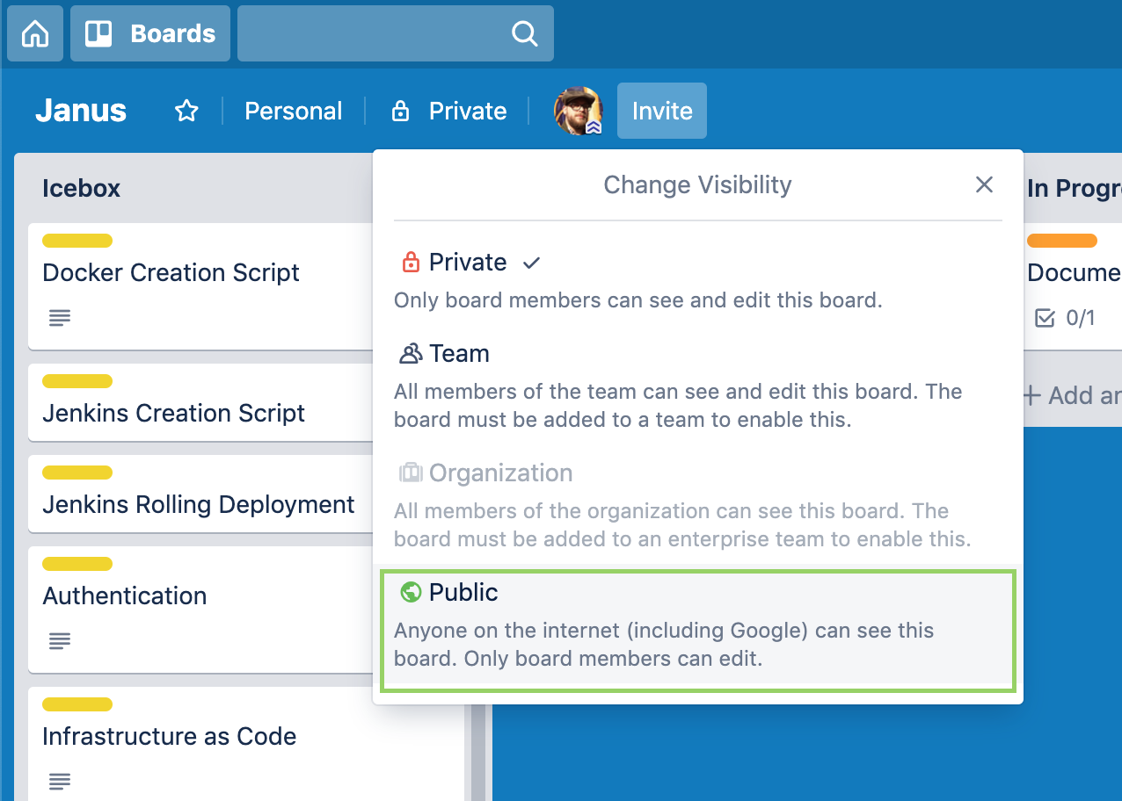
Trello Visibility Settings

Slide 18
Lecture

Slide 19

Class 1 Objectives
Get to know your group and mentors
Review Liftoff expectations
Understand capstone goals
Key components of a capstone
Solidify project ideas
Story Mapping, Personas, and User Stories

Slide 20
How do you ideate
and build a project?

Slide 21
But first, 50 years of software history in 5 minutes...

Slide 22
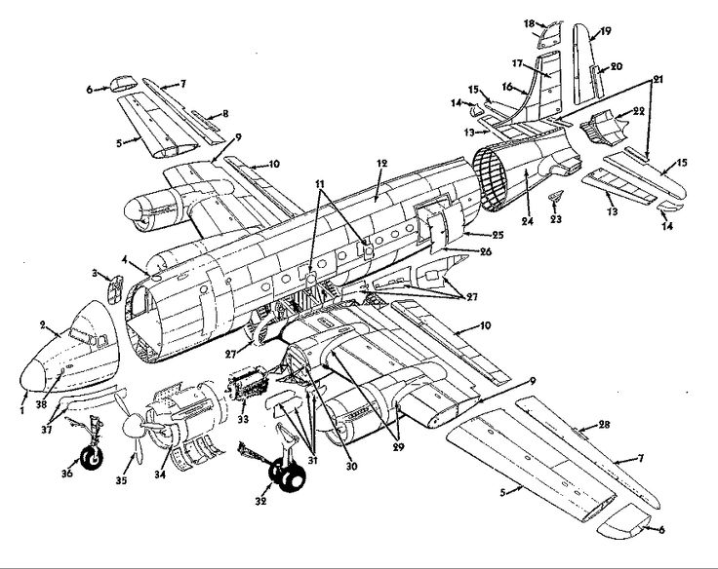
Software Development Life Cycle
Organizations needed ways to manage software development projects
Dozens of methodologies, frameworks, disciplines, practices, paradigms, processes, models, diagrams, and very shiny powerpoint presentations with arrows and too much text on the screen
Waterfall vs Agile

Slide 23
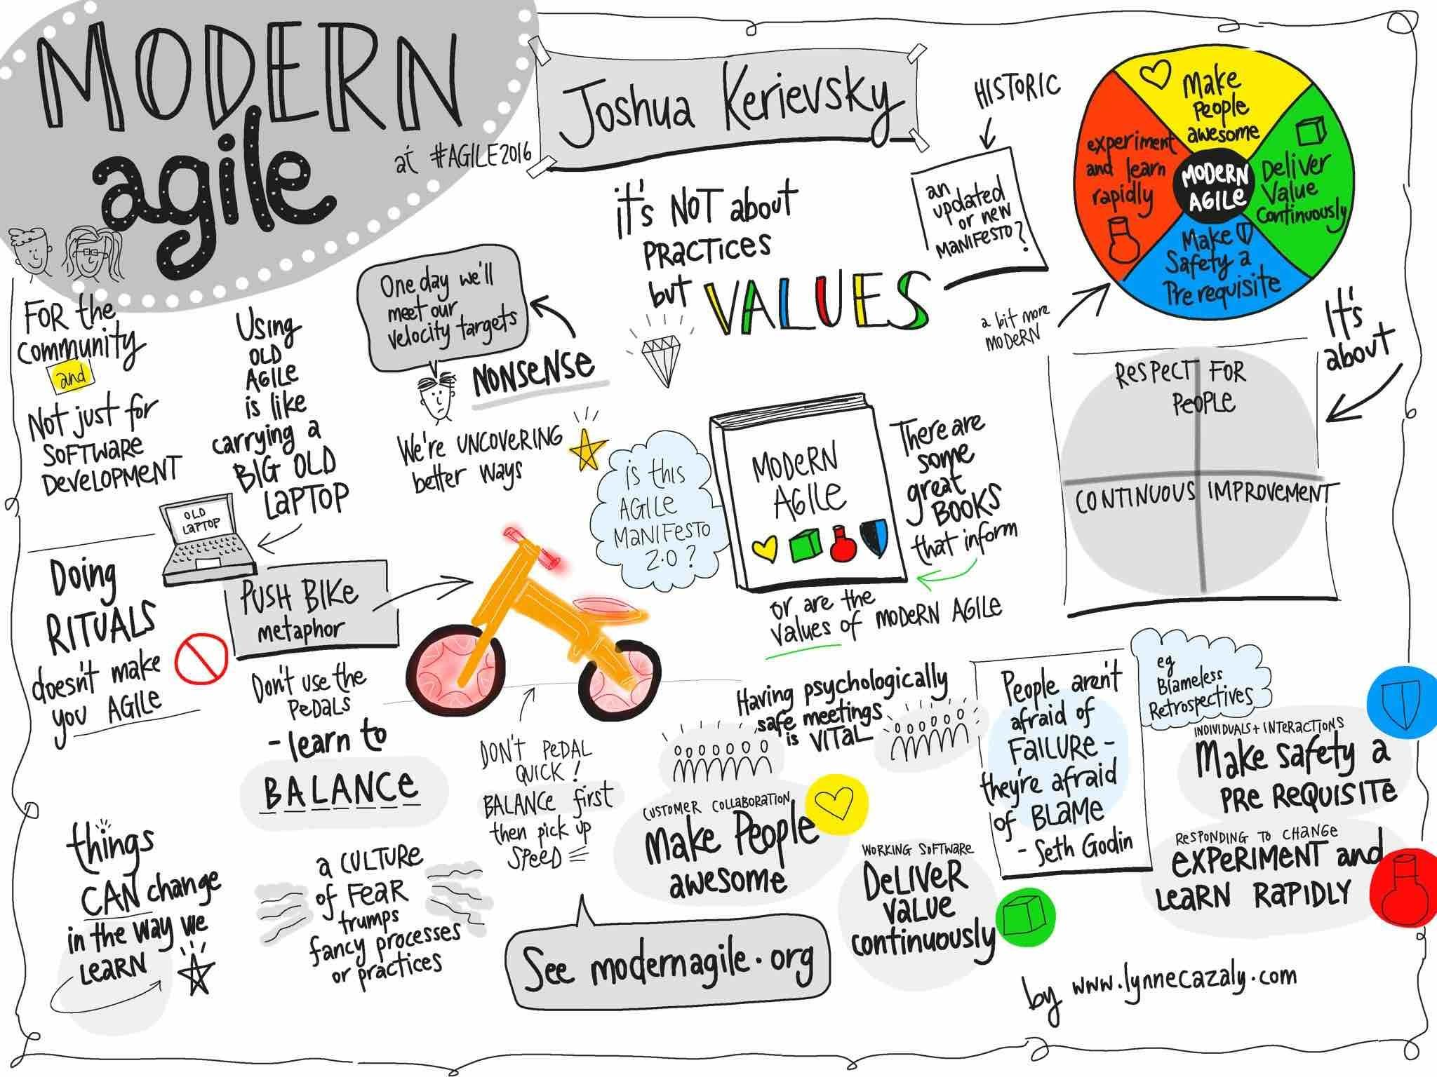

Slide 24
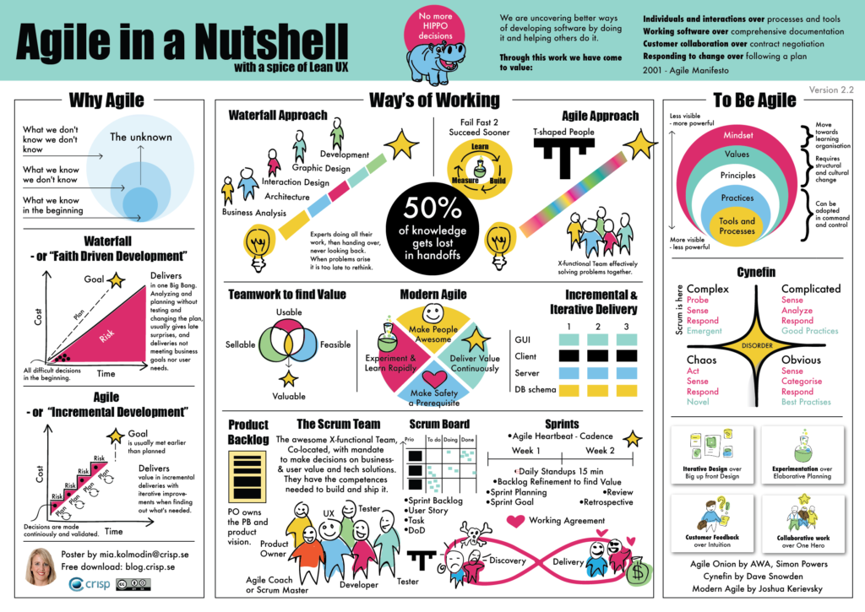

Slide 25
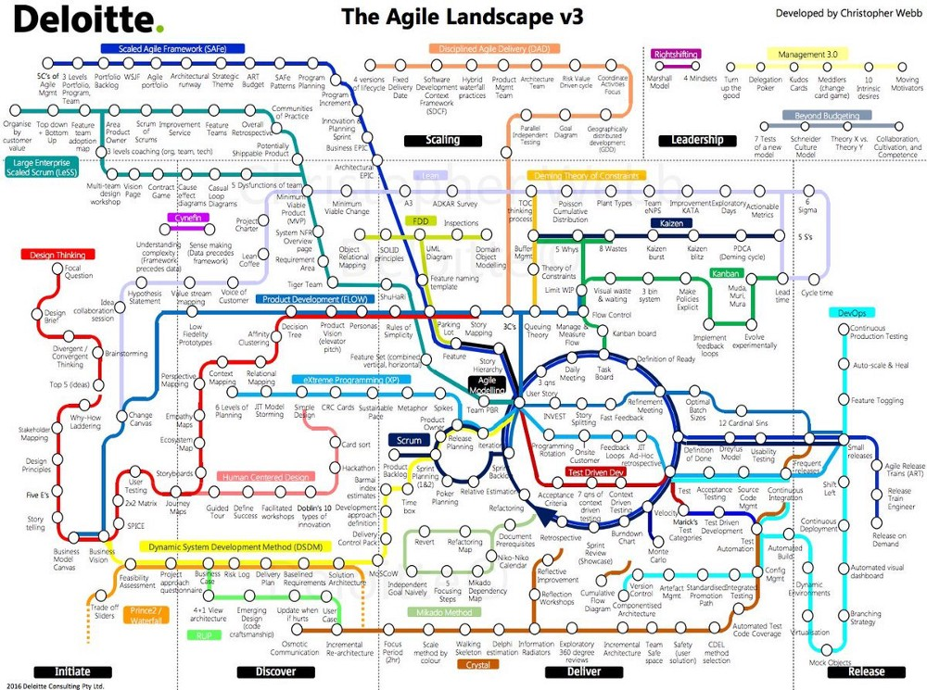
How’s that for diagrams?

Slide 26
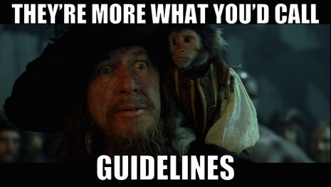
What is Agile?
Agile is a framework, not a prescription
Not everyone does Agile
Those who do, do so differently
Refer to Agile Manifesto
https://agilemanifesto.org/

Slide 27
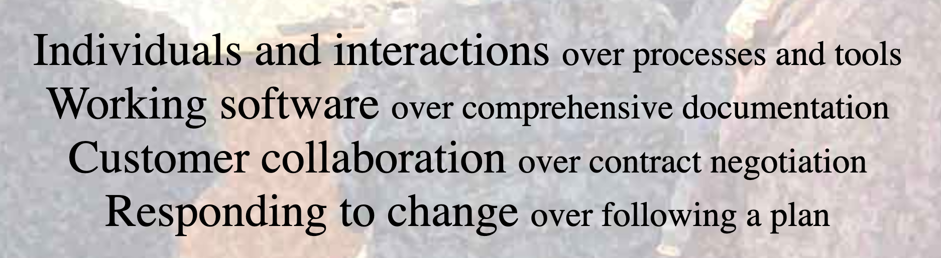
https://agilemanifesto.org/

Slide 28
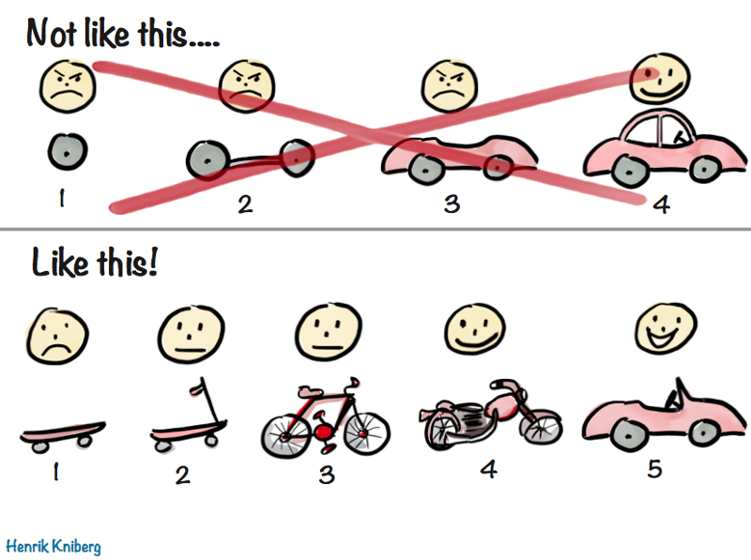
User Feedback and Iterative Design

Slide 29
Why is Agile Important?
The “Way Things Were” - An Analogy
You Can’t Plan For Everything
Small, Iterative, Feedback Driven Development
Personal Project & Task Management
Employers Want Agile Mindsets
Notes:
RE: Prep Work - Take a step back and understand a bit about Agile,
Will revisit over the next few weeks
Lots of buzzwords & concepts - hope to demystify
Agile is just a way to plan, manage and build projects
Not everyone does agile, and no one does it the same way - concepts are the same

Slide 30
Personal Agile
Many Developers Fail at Building Projects
Humans are Bad at Task Management
How to Break Down the “Big Rocks”
Smaller Units of Work are More Manageable and Rewarding
Notes:
No longer spoon fed what and how to build a project

Slide 31
Agile Brainstorming & Process
Identify the Problem and Set a Goal (Brainstorming)
Identify Users (Personas)
Brainstorm the “Big Picture” (Story Mapping)
Target a Minimum Viable Product (MVP)
Create small, “vertical” tasks (User Stories)
Get Feedback (User Demos & Code Review)
Lather, Rinse, Repeat (Iterate)

Slide 32
Different Agile Methodologies
There are several different “implementations” or “methodologies” of Agile
Two of the more popular ones are Scrum and Kanban
Scrum – Set of meetings (ceremonies), tools, and roles that work together to achieve a goal
https://www.atlassian.com/agile/scrum
Kanban – Full transparency of work usually through a “Kanban Board”
https://www.atlassian.com/agile/kanban

Slide 33
Intellectual Property

Slide 34

Your Property Rights and You!
You Own Your Code
Sell It (Work)
Give it (Open Source)
Do Neither (Own It)
Employer IP Contract

Slide 35

Licensing
https://choosealicense.com/
Common Questions
Should I include a license?
What license should I choose?
What If I don’t include a license?
What about code I copy/paste from Stack Overflow?
Even loops or common patterns?
Notes:
SO: Creative Commons - You really shouldn’t re-use :D https://stackoverflow.com/help/licensing
You still have exclusive copyright over GitHub code you’ve pushed

Slide 36

Open Source
Give Back to the OSS Community
In-depth Learning
Great Resume Fodder
http://www.firsttimersonly.com/
https://opensourcefriday.com/
Most of Your Tools and Libraries are OSS!

Slide 37
Story Mapping

Slide 38
Story Mapping
Identifying Key Features (Epics)
Epics Are the Key Features of Your Application
Details That Build the Epic (Stories)
How a User Interacts With that Feature
Alternative Solutions
Not Detailed and Focused Like a User Story
Struggling to Find Epics?
Focus on Rough Stories
Group and Sort by User’s Journey
Groups can Form Epics
Notes:
Show a Couple Examples, then Demo
Features can be a “muddied” term

Slide 39
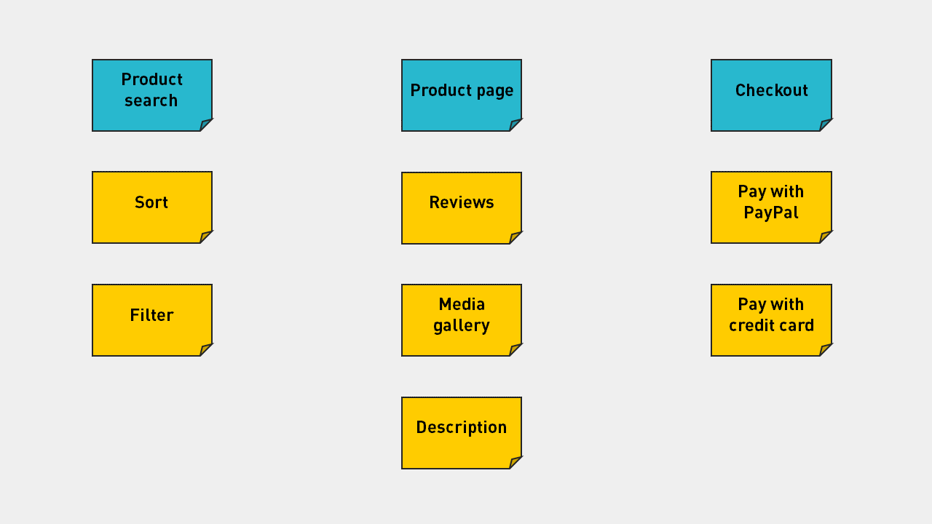
Story Mapping - eCommerce Example
Notes:
Identify Key Features - ecommerce example - Search, product, checkout

Slide 40
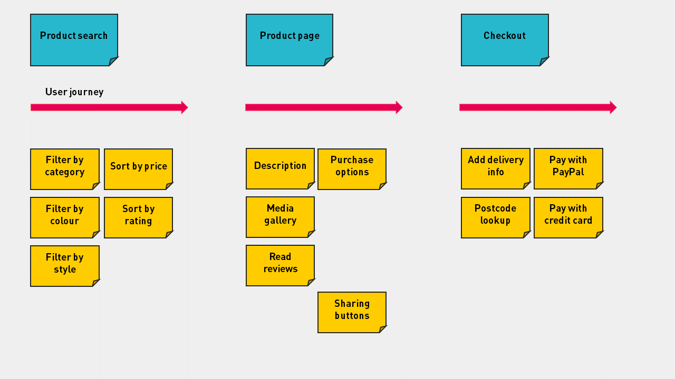
Creating Stories - eCommerce Example

Slide 41
Identifying Your MVP
MVP or minimally viable product
What is the least amount of work I can do in order to show functionality?
Think “Skateboard”, not “Wheels”
Additional Stories are Put on the Backlog
Notes:
The key is to have something workable, as hopefully you can show employers at any time

Slide 42
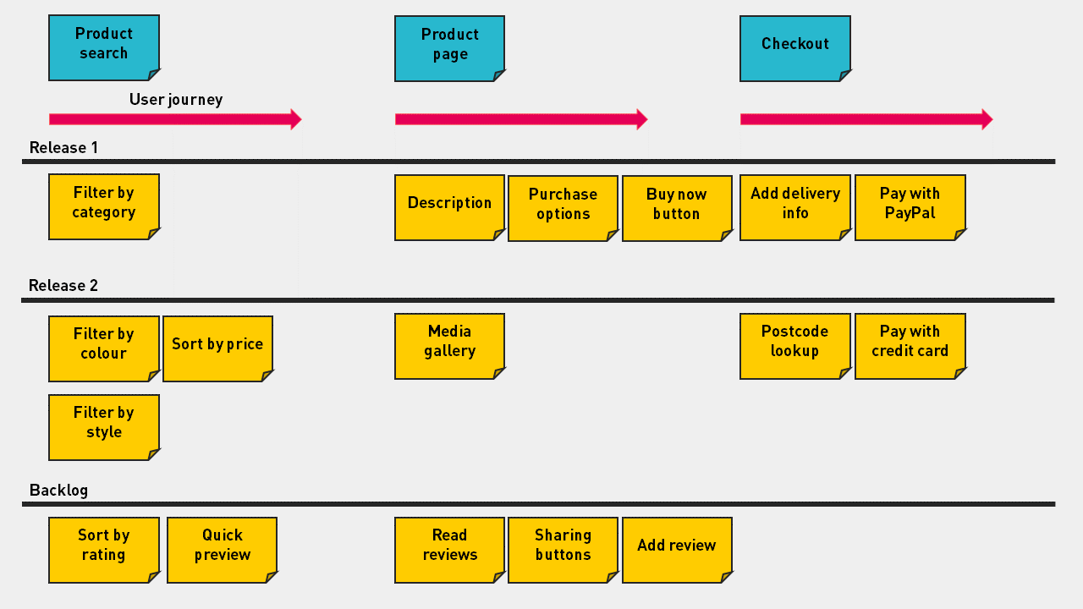
Identify Your MVP - eCommerce Example

Slide 43
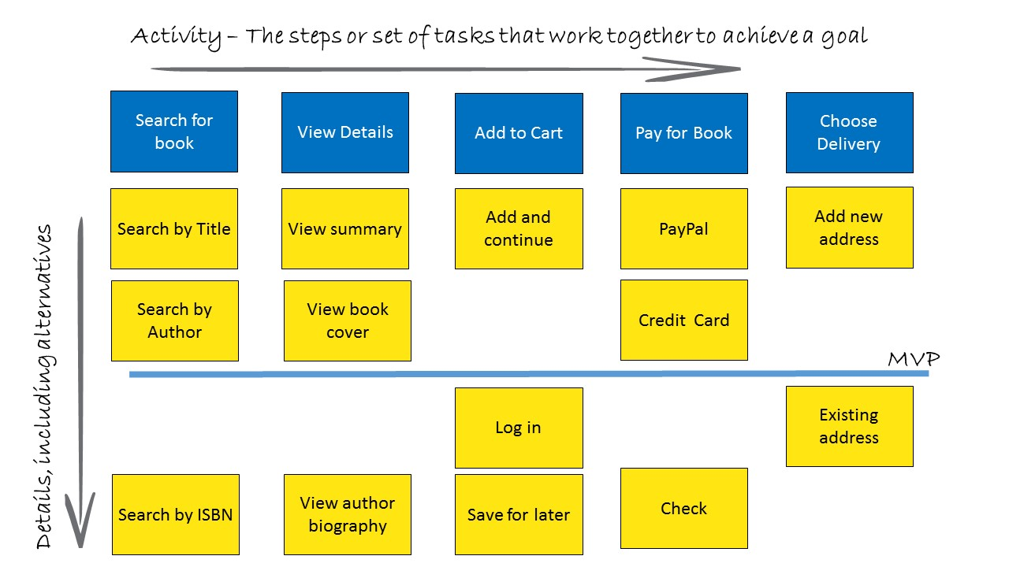
Story Mapping - Bookstore Example
Notes:
Notice non-essential features are below MVP (Log In)

Slide 44
Creating User Stories
As a <persona>, I want to <do something>, so that <end result>
Gives Context to a Task (Who, What, Why)
Smaller is Better
Vertical Slicing - Focused on User’s Experience
Examples:
As a shopper, I want a landing page when I visit the site, so that I know I’m in the right spot
As a seller, I want to provide a good description, so that shoppers know what they’re buying
As a shopper, I want to view by category, so that I quickly find what I need
As a shopper, I want to pay using PayPal, so that I can easily complete my purchase

Slide 45
Agile Topics Review
Personas
Story Mapping
User Stories
Next Class:
Features
MVP

Slide 46
Assignment - Capstone Project Overview
1-2 Paragraph “Elevator Pitch”
Identify 3-5 Features
List Technologies
Identify Unknowns - What you need to learn
Setup Project Tracker and Add Initial User Stories
Enable GitHub Issues
Mentors - Feedback on overview, identify learning resources
Notes:
Identify blockers early

Slide 47
Q&A

Slide 48
Activity: Get to know your group!
Introductions
Share project idea

Slide 49
Activity: Brainstorming
Narrow down project idea with mentor
Begin Story Mapping
Have mentor review User Story

Slide 50
Meet Your Teaching Fellows/Mentors for Liftoff
Abbey
Andrew
Antwan
Britaney
Christian
Christopher
Dan
Gabby
Javan
Jay
Jayke
Ken
Koki
Maricar
Mario
Meagan
Mehmet
Jane
Shreya
Sunitha
Miguel
Tobias
Tom
Zac
Zachary

